Slide 1

Web Development
Task List

Slide 2
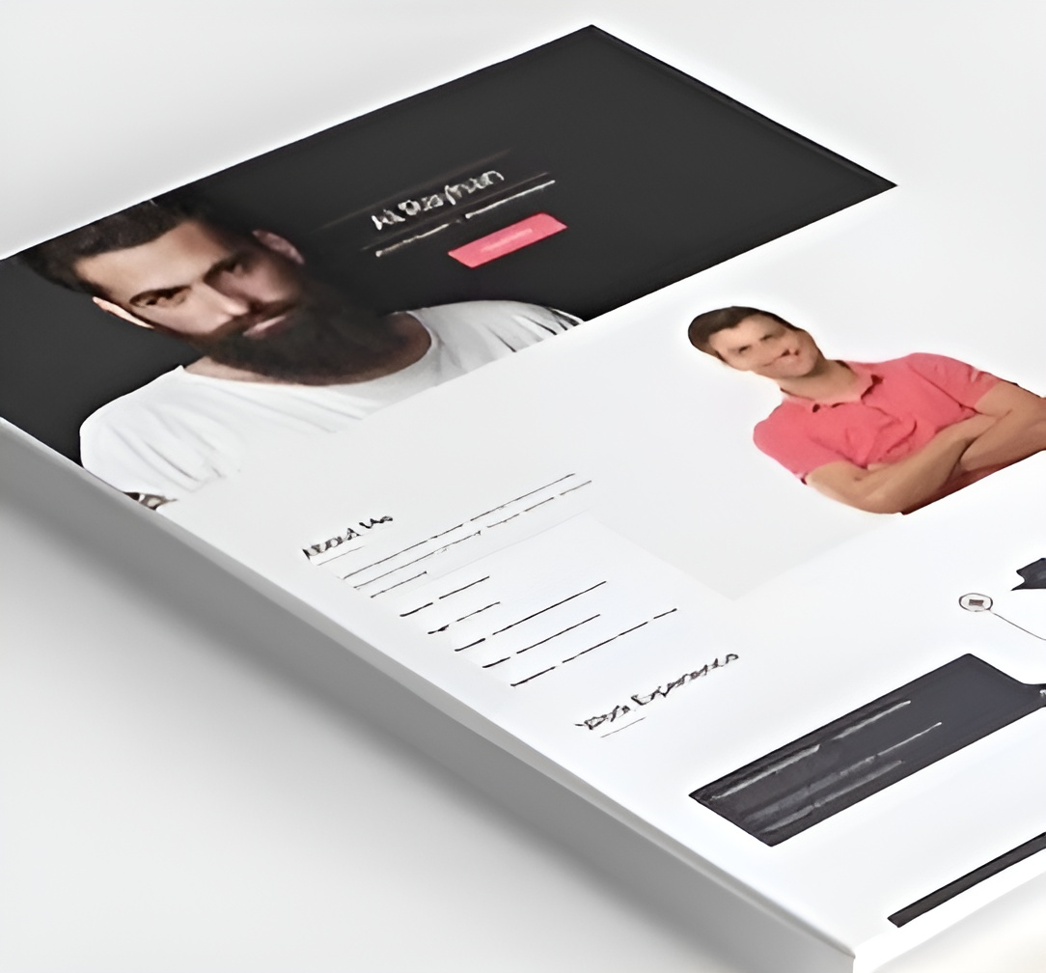
TASK 1
Personal Portfolio
Create a simple personal website that includes your name, a brief bio, contact information, and links to your social media profiles. This project is an excellent way to introduce yourself online and practice HTML and CSS.

Slide 3



7579577321
www.innovixiontech.online
www.linkedin/innovixiontech

